Slide 1
Example 1: The Sum of Powers Problem
A visual approach to solving a classic problem.
Notes:
(%)This is often asked in quantitative finance interviews to see if you have the necessary mathematical background for the job. They usually expect you to know the formulas for the simplest cases and may ask you to explain how you got them.

Slide 2

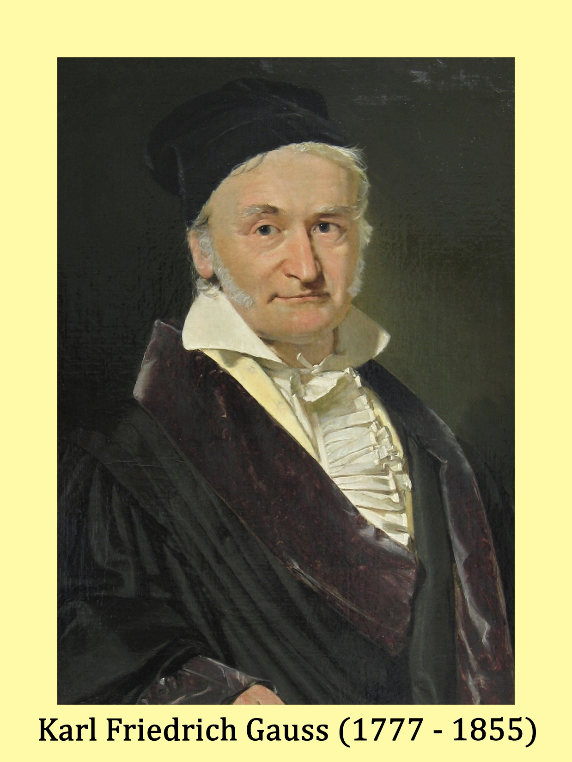
Class, you will add from 1 to 100. You will add 2 to 1, then 3, then 4, and so on until you reach 100. You are not allowed to leave for recess until you show me the right answer!
Angry Math
Teacher
(a few minutes later)
It’s 5050.
Notes:
(%)There’s a well known story that when Karl Gauss was a boy in elementary school, his math teacher got mad at the class and she made the class add the numbers from 1 to 100. Young Gauss was able to come up with the right answer in a few minutes. Gauss is well-known for the Normal Gaussian Distribution which is a very common continuous probability distribution used in many, many fields.

Slide 3
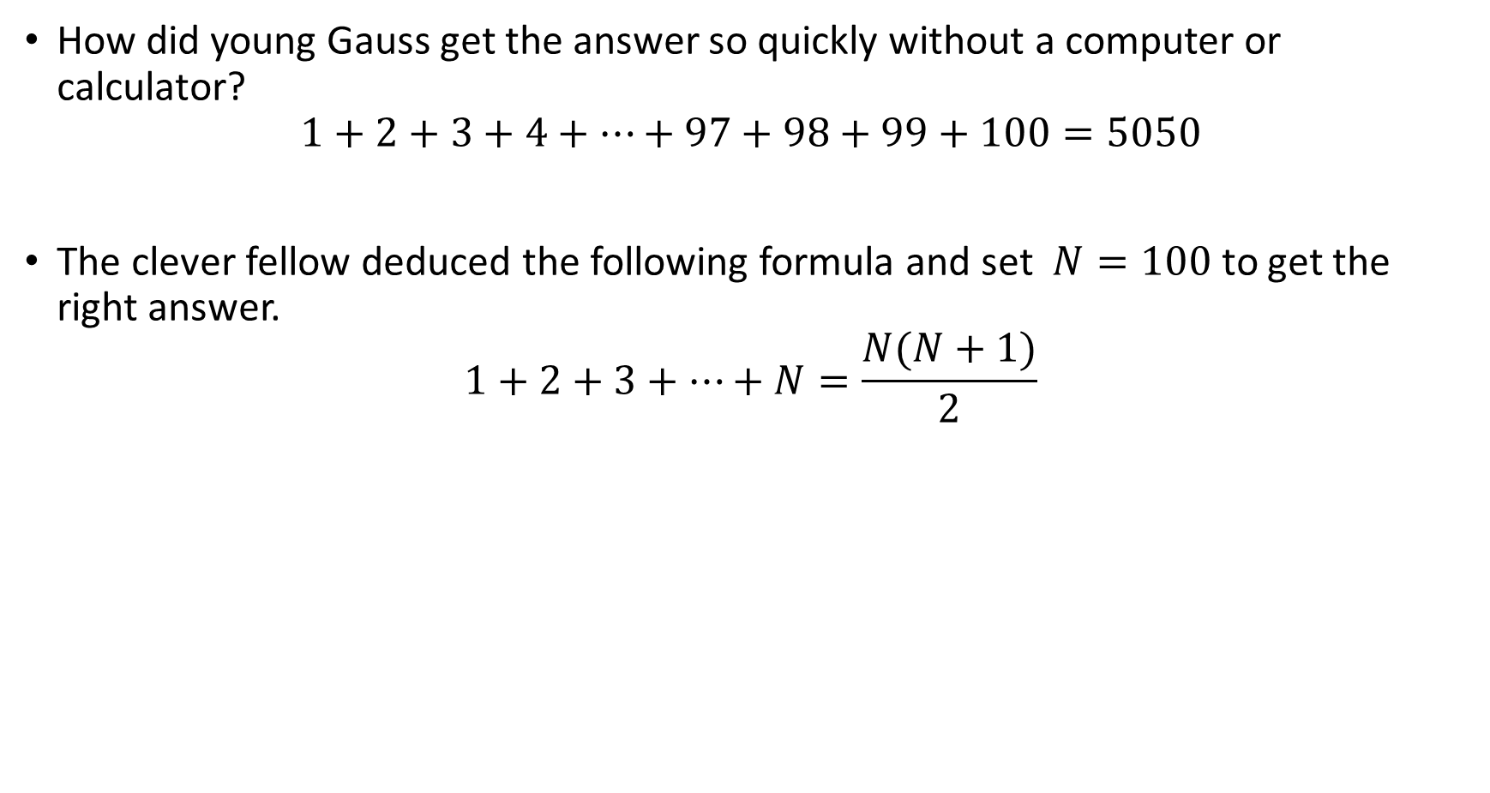
How did young Gauss get the answer so quickly without a computer or calculator?
$$1+2+3+4+⋯+97+98+99+100=5050$$
The clever fellow deduced the following formula and set $N=100$ to get the right answer.
$$1+2+3+⋯+N=\frac{N(N+1)}{2}$$
Notes:
(%)It’s obvious that Gauss did not add the numbers one after another sequentially like the teacher said. The formula is the simplest Sum of Powers Formula.

Slide 4

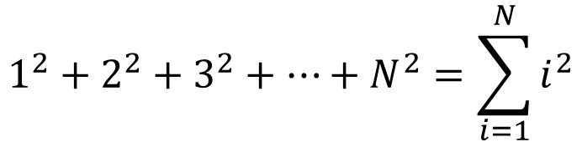
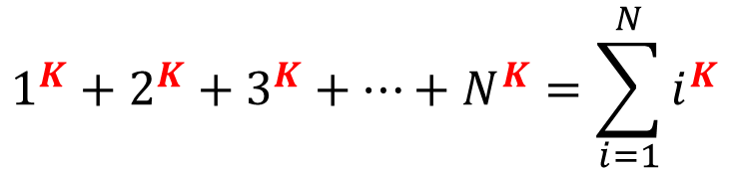
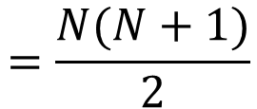
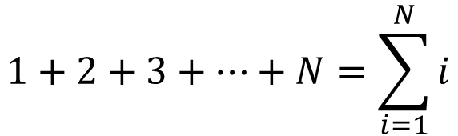
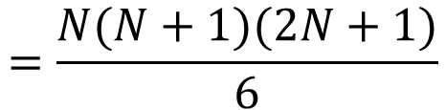
The Sum of Powers formulas
$$1+2+3+⋯+N=\sum_{i=1}^{N}{i}$$
$$=\frac{N(N+1)}{2}$$
$$1^{2}+2^{2}+3^{2}+⋯+N^{2}=\sum_{i=1}^{N}{i^{2}}$$
$$=\frac{N(N+1)(2N+1)}{6}$$
$$1^{K}+2^{K}+3^{K}+⋯+N^{K}=\sum_{i=1}^{N}{i^{K}}$$
$$=$$
???
Notes:
(%)The first formula, the sum of the 1st power, is the one deduced by young Gauss. The next one is the sum of the 2nd power.
(%) In general, the sum of the Kth power is the sum of the integers raised to the power K.
I will show how the sum of the 1st power can be derived using a visual approach. Then I will show how this can be done for the sum of the second power. And I will show how to derive the formulas for the higher powers in general.
If the math teacher were really mean, she could have asked the class to find the sum from 1 to 100 of the second series. That way, the students would have gotten in both their multiplication and addition practice. Of course, a student today can write a computer program or use Excel to get the answer.

Slide 5



Sum of 1st Power:
$$4×5$$
$$1+2+3+4$$
$$1+2+3+4$$
Notes:
(%)The sum of 1 to 4 is the number of squares in the pyramid. We rotate the second pyramid 180 degrees and fit the two pyramids together to get a 4x5 rectangle. Since there are two pyramids in the rectangle, the sum of 1 to 4 is half the area of the rectangle.

Slide 6

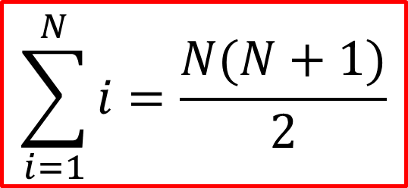
Sum of 1st Power:
$$2×\left(1+2+3+4\right)=4×5$$
$$2×\left(1+2+⋯+N\right)=N\left(N+1\right)$$
$$\sum_{i=1}^{N}{i=\frac{N(N+1)}{2}}$$
Notes:
(%) So 2 times the sum of 1 to 4 is equal to 4 times 5. We generalize this from 4 to N in the next equation.
(%) And after dividing both sides by 2, we get the formula.

Slide 7

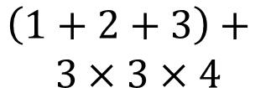


Sum of 2nd Power:
$$1^{2}+2^{2}+3^{2}$$
$$1^{2}+2^{2}+3^{2}$$
$$\begin{matrix}\left(1+2+3\right)+ \\ 3×3×4\end{matrix}$$
$$1^{2}+2^{2}+3^{2}$$
Notes:
(%) The sum of 1^2 to 3^2 is the number of cubes in the 3-dim pyramid. We put three of these pyramids together to form a box-shaped volume that is made up of a 3x3x4 lower part and an upper part that is the sum from 1 to 3. Yes, I loved Lego as a kid.

Slide 8

Sum of 2nd Power:
$$3×\left(1^{2}+2^{2}+3^{2}\right)=\left(1+2+3\right)+3×3×4$$
$$3×\left(1^{2}+2^{2}+⋯+N^{2}\right)=\left(1+2+⋯+N\right)+N×N×(N+1)$$
$$\sum_{i=1}^{N}{i^{2}=\frac{N(N+1)(2N+1)}{6}}$$
Notes:
(%) The equation for the picture is shown on top. The generalization to N is shown next.
(%) And by doing a bit of algebra, we get the formula.

Slide 9
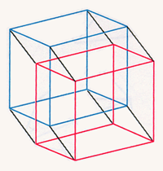
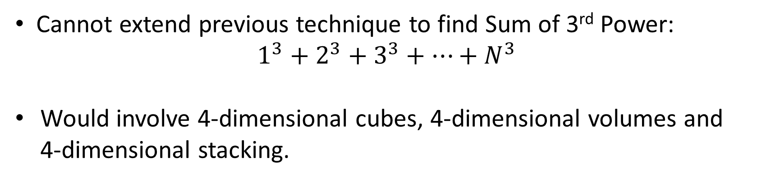
Cannot extend previous technique to find Sum of 3rd Power:
$$1^{3}+2^{3}+3^{3}+⋯+N^{3}$$
Would involve 4-dimensional cubes, 4-dimensional volumes and 4-dimensional stacking.
Visual representation of a 4-dimensional cube
Notes:
(%) It would be hard to extend the previous technique to find the sum of the 3rd power. It would involve 4-dim cubes, volumes and stacking. I think this is beyond the capability of most people. Here we have a 4-dim cube. It would be indeed wise stop at the second power. So we need a new way of “seeing” the formula.

Slide 10


We know ${(1+2+3)}^{2}=6^{2}=1^{3}+2^{3}+3^{3}$
Idea !!!
3x(1+2²+3²)
3³=27
2³=8
1
1
2²=4
$$6^{2}$$
3²=9
Notes:
(%) We know that 6^2 is the sum of 1^3 to 3^3. We rearrange the squares to form rectangles corresponding to 1^3, 2^3 and 3^3. We see that the lined up rectangles can be enclosed in a larger rectangle of known dimensions 3 times the sum of 1^2 to 3^2.

Slide 11
Sum of 3rd Power:
Area = 4x(1²+2²+3²)
1²+2²+3²
1+2²+3²
1+2²
3³=27
4
1
2³=8
1
1
2²
3²
Notes:
(%) We start with the pyramid corresponding to the cubed numbers. We add in the strips to complete the rectangle of size 4 X (1^2+2^2+3^2). The area of the rectangle must be equal to the sum of the areas of its component parts.

Slide 12
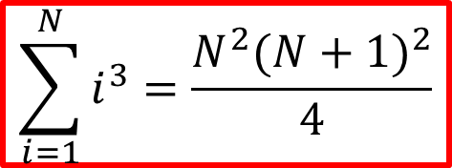
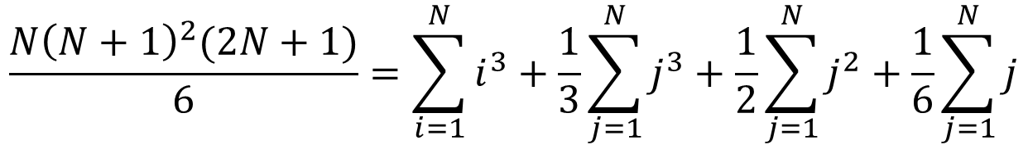
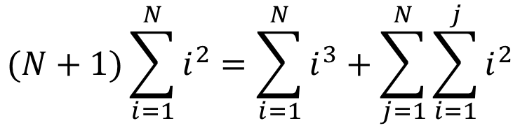
Sum of 3rd Power:
$4×\left(1^{2}+2^{2}+3^{2}\right)$ $=\left(1^{3}+2^{3}+3^{3}\right)+1^{2}+\left(1^{2}+2^{2}\right)+(1^{2}+2^{2}+3^{2})$
$(N+1)\left(1^{2}+⋯+N^{2}\right)$ $=\left(1^{3}+⋯+N^{3}\right)+1^{2}+\left(1^{2}+2^{2}\right)+⋯+\left(1^{2}+⋯+N^{2}\right)$
$$(N+1)\sum_{i=1}^{N}{i^{2}=\sum_{i=1}^{N}{i^{3}+\sum_{j=1}^{N}{\sum_{i=1}^{j}{i^{2}}}}}$$
$$\frac{N{\left(N+1\right)}^{2}(2N+1)}{6}=\sum_{i=1}^{N}{i^{3}+\frac{1}{3}\sum_{j=1}^{N}{j^{3}+\frac{1}{2}\sum_{j=1}^{N}{j^{2}+\frac{1}{6}\sum_{j=1}^{N}{j}}}}$$
$$\sum_{i=1}^{N}{i^{3}=\frac{N^{2}{(N+1)}^{2}}{4}}$$
Notes:
(%) The first equation equates the area of the rectangle to the areas of its components. The second is a generalization from 3 to N.
(%) Putting it into summation form, then doing the necessary algebra, we get the formula for the sum of the 3rd power.

Slide 13
Sum of K^{th} Power:
Area=4x(1^{K-1}+2^{K-1}+3^{K-1})
1^{K-1}+2^{K-1}+3^{K-1}
1+2^{K-1}+3^{K-1}
1+2^{K-1}
3^{K}
4
1
2^{K}
1
K=0
1
2^{K-1}
3^{K-1}
Notes:
(%) The sum of Kth power can be visualized in exactly the same way. And the formula is derived by equating the area of the rectangle as a whole to that of its component parts.
(%) When K=0, we get back our original picture for the sum of the 1st power.

Slide 14
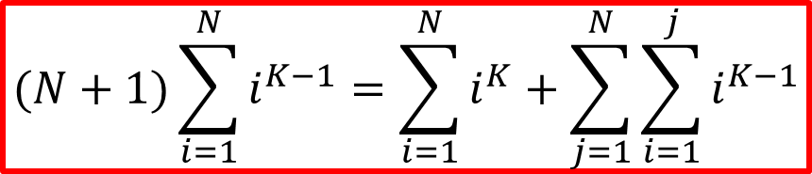
Sum of K^{th} Power:
$4×\left(1^{K−1}+2^{K−1}+3^{K−1}\right)$ $=\left(1^{K}+2^{K}+3^{K}\right)+1^{K−1}+\left(1^{K−1}+2^{K−1}\right)+ (1^{K−1}+2^{K−1}+3^{K−1})$
$(N+1)\left(1^{K−1}+⋯+N^{K−1}\right)$ $=\left(1^{K}+⋯+N^{K}\right)+1^{K−1}+\left(1^{K−1}+2^{K−1}\right)+ +⋯+(1^{K−1}+2^{K−1}+N^{K−1})$
$$(N+1)\sum_{i=1}^{N}{i^{K−1}=\sum_{i=1}^{N}{i^{K}+\sum_{j=1}^{N}{\sum_{i=1}^{j}{i^{K−1}}}}}$$
Notes:
(%) Putting everything into equations, we arrive at the formula at the bottom.

Slide 15

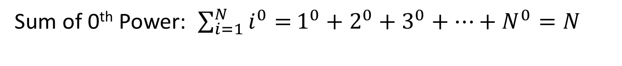
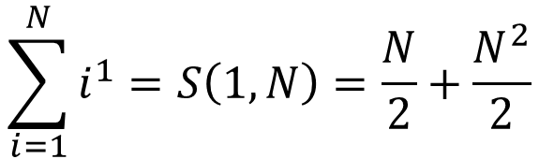
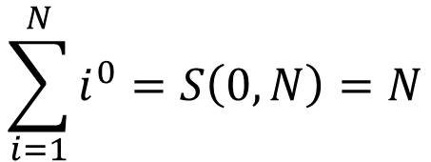
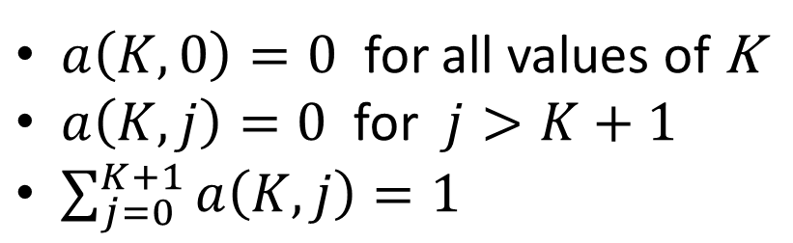
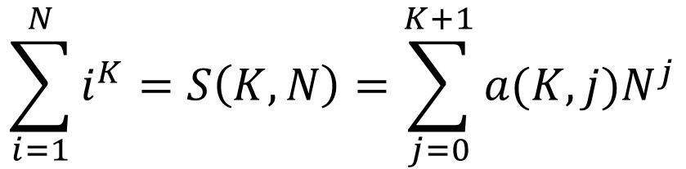
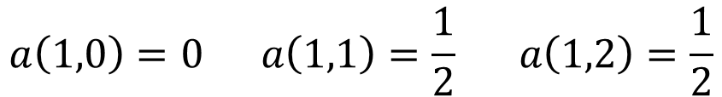
Sum of 0th Power: ${\sum_{i=1}^{N}{i^{0}=}1}^{0}+2^{0}+3^{0}+⋯+N^{0}=N$
Expressing the sum of power as a polynomial function of N :
$$\sum_{i=1}^{N}{i^{K}=S\left(K,N\right)=\sum_{j=0}^{K+1}{a(K,j)N^{j}}}$$
$a\left(K,0\right)=0$ for all values of K
$a\left(K,j\right)=0$ for $j>K+1$
$\sum_{j=0}^{K+1}{a\left(K,j\right)=1}$
$$\sum_{i=1}^{N}{i^{0}=S\left(0,N\right)=N}$$
$$a\left(0,0\right)=0 a\left(0,1\right)=1$$
$$\sum_{i=1}^{N}{i^{1}=S\left(1,N\right)=\frac{N}{2}+\frac{N^{2}}{2}}$$
$$a\left(1,0\right)=0 a\left(1,1\right)=\frac{1}{2} a\left(1,2\right)=\frac{1}{2}$$
Notes:
(%) The sum of the zeroth power is just the sum of N ones.
(%) We can express the sum of power as a polynomial function of N.
(%) Some properties of the coefficient a(K,j).
(%) The polynomials of the zeroth and 1st powers and their coefficients

Slide 16
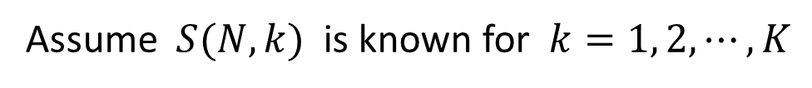
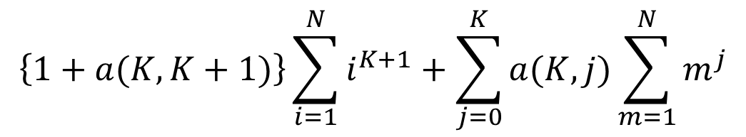
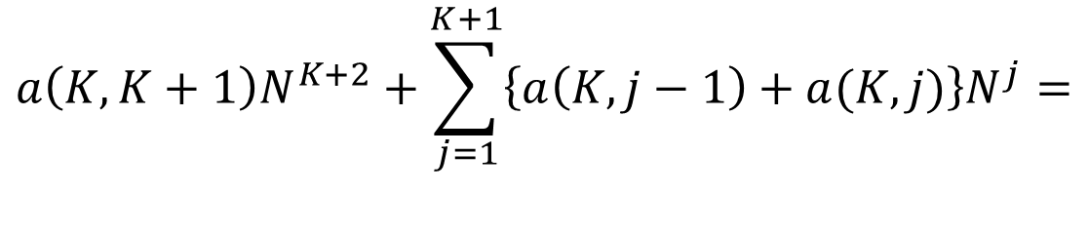
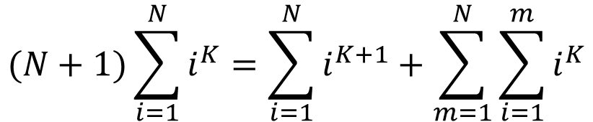
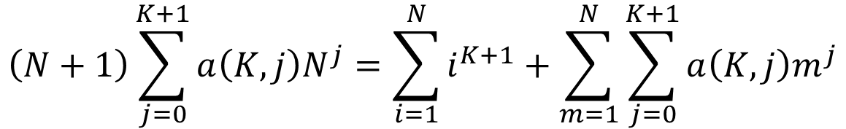
Sum of (K+1)^{st} Power:
Assume $S(N,k)$ is known for $k=1, 2, ⋯,K$
$$(N+1)\sum_{i=1}^{N}{i^{K}=\sum_{i=1}^{N}{i^{K+1}+\sum_{m=1}^{N}{\sum_{i=1}^{m}{i^{K}}}}}$$
$$\left(N+1\right)\sum_{j=0}^{K+1}{a\left(K,j\right)N^{j}}=\sum_{i=1}^{N}{i^{K+1}}+\sum_{m=1}^{N}{\sum_{j=0}^{K+1}{a\left(K,j\right)m^{j}}}$$
$$a\left(K,K+1\right)N^{K+2}+\sum_{j=1}^{K+1}{\left\{a\left(K,j−1\right)+a(K,j)\right\}N^{j}}=$$
$$\left\{1+a(K,K+1)\right\}\sum_{i=1}^{N}{i^{K+1}}+\sum_{j=0}^{K}{a(K,j)}\sum_{m=1}^{N}{m^{j}}$$
Notes:
(%) If we know the polynomials for the first to Kth power, we can get the one for the (K+1)st power. We start with the top equation that we derived earlier and plug in the polynomial function for the sum of the Kth power.
(%) After some algebraic manipulation, we get the bottom equation.

Slide 17
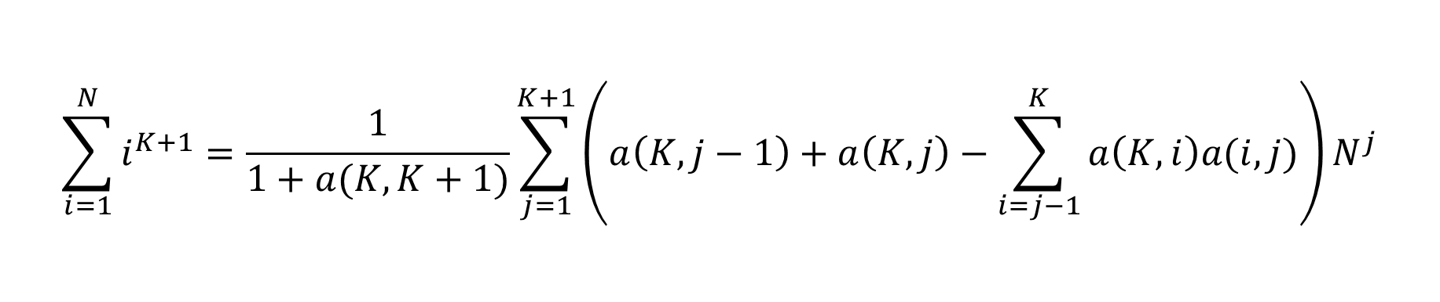
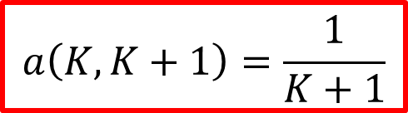

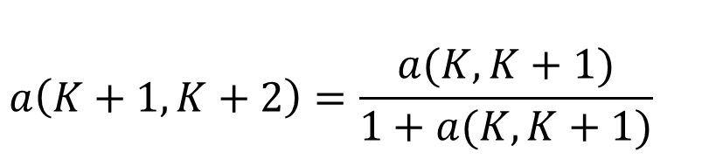
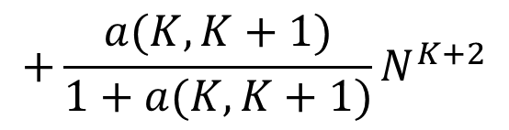
$$\sum_{i=1}^{N}{i^{K+1}}=\frac{1}{1+a(K,K+1)}\sum_{j=1}^{K+1}{\left(a\left(K,j−1\right)+a\left(K,j\right)−\sum_{i=j−1}^{K}{a\left(K,i\right)a(i,j)}\right)N^{j}}$$
Sum of (K+1)^{st} Power:
$$+\frac{a(K,K+1)}{1+a(K,K+1)}N^{K+2}$$
$$a\left(K+1,K+2\right)=\frac{a(K,K+1)}{1+a(K,K+1)}$$
$$a\left(K,K+1\right)=\frac{1}{K+1}$$
$$a\left(0,1\right)=1$$
Notes:
(%) After gathering like powers of N, we get the long equation at the top.
(%) The coefficient for N^K+2 is only dependent on the coefficient for N^K+1 of the previous power.
(%) Since a(0,1)=1, we easily deduce the result in the red box.

Slide 18
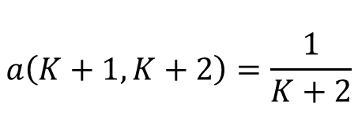
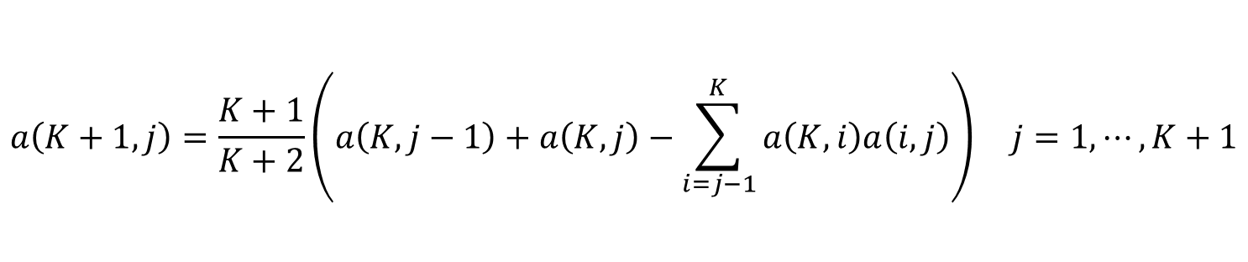
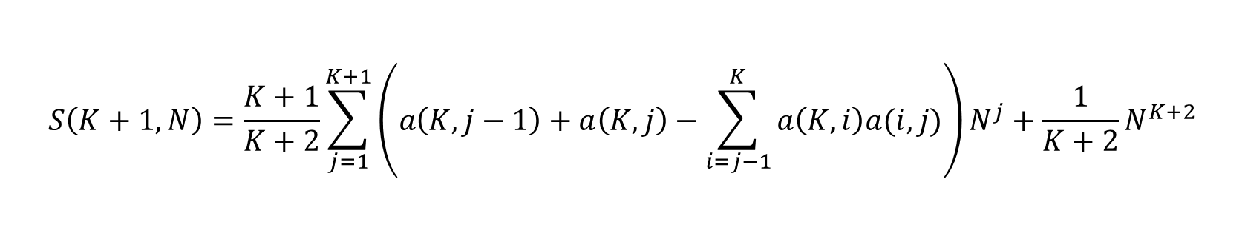
Sum of (K+1)^{st} Power: $S\left(K+1,N\right)=1^{K+1}+2^{K+1}+3^{K+1}+⋯+N^{K+1}$
$$S\left(K+1,N\right)=\frac{K+1}{K+2}\sum_{j=1}^{K+1}{\left(a\left(K,j−1\right)+a\left(K,j\right)−\sum_{i=j−1}^{K}{a\left(K,i\right)a(i,j)}\right)N^{j}+\frac{1}{K+2}N^{K+2}}$$
$$a\left(K+1,j\right)=\frac{K+1}{K+2}\left(a\left(K,j−1\right)+a\left(K,j\right)−\sum_{i=j−1}^{K}{a\left(K,i\right)a\left(i,j\right)}\right) j=1,⋯,K+1$$
$$a\left(K+1,K+2\right)=\frac{1}{K+2}$$
Notes:
(%) With the last result, we pretty up the equation a bit. And the formula for the coefficients for the K+1 power are shown. I always believe it’s good to try out all formulas with actual numbers. And some results are shown in the next few slides.

Slide 19
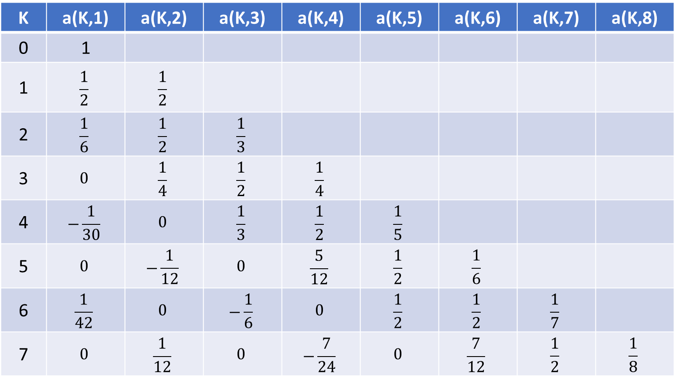
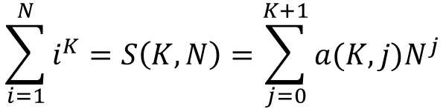
$$\sum_{i=1}^{N}{i^{K}=S\left(K,N\right)=\sum_{j=0}^{K+1}{a(K,j)N^{j}}}$$
Bernoulli numbers
K | a(K,1) | a(K,2) | a(K,3) | a(K,4) | a(K,5) | a(K,6) | a(K,7) | a(K,8)
0 | 1
1 | $$\frac{1}{2}$$ | $$\frac{1}{2}$$
2 | $$\frac{1}{6}$$ | $$\frac{1}{2}$$ | $$\frac{1}{3}$$
3 | $$0$$ | $$\frac{1}{4}$$ | $$\frac{1}{2}$$ | $$\frac{1}{4}$$
4 | $$−\frac{1}{30}$$ | $$0$$ | $$\frac{1}{3}$$ | $$\frac{1}{2}$$ | $$\frac{1}{5}$$
5 | $$0$$ | $$−\frac{1}{12}$$ | $$0$$ | $$\frac{5}{12}$$ | $$\frac{1}{2}$$ | $$\frac{1}{6}$$
6 | $$\frac{1}{42}$$ | $$0$$ | $$−\frac{1}{6}$$ | $$0$$ | $$\frac{1}{2}$$ | $$\frac{1}{2}$$ | $$\frac{1}{7}$$
7 | $$0$$ | $$\frac{1}{12}$$ | $$0$$ | $$−\frac{7}{24}$$ | $$0$$ | $$\frac{7}{12}$$ | $$\frac{1}{2}$$ | $$\frac{1}{8}$$
Notes:
(%) Here are the values of the coefficients for the first seven powers. The diagonal values are as expected. But also see ½ sub-diagonal right beneath it and the zero sub-diagonals.
(%) The values in the 1st column are very familiar and well-known in mathematics. They are the Bernoulli numbers.

Slide 20
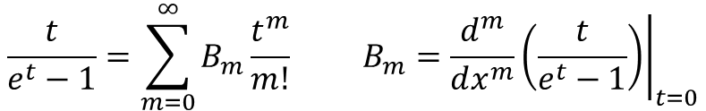
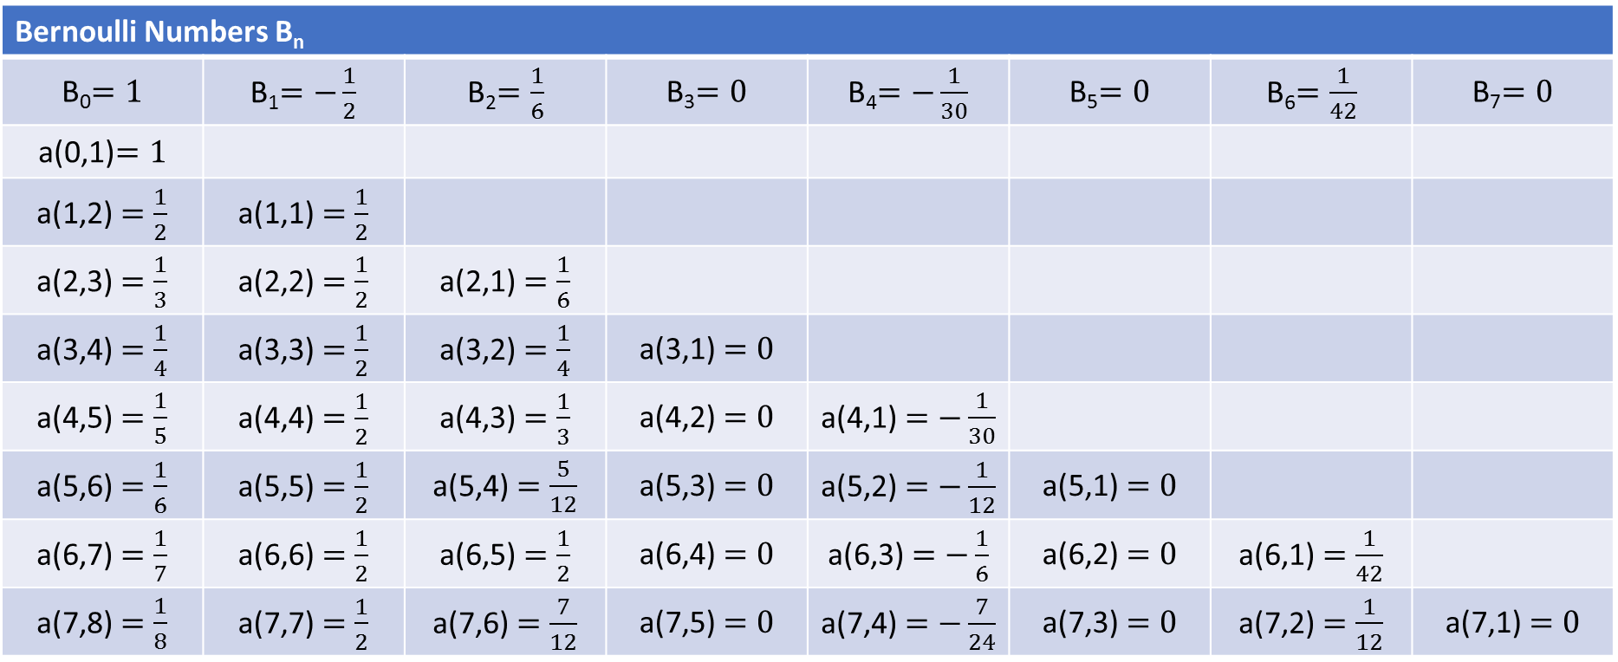
Bernoulli Numbers B_{m} :
$$\frac{t}{e^{t}−1}=\sum_{m=0}^{∞}{B_{m}\frac{t^{m}}{m!} B_{m}={\left.\frac{d^{m}}{dx^{m}}\left(\frac{t}{e^{t}−1}\right)\right|}_{t=0}}$$
Bernoulli Numbers B_{n}
B₀$=1$ | B₁$=−\frac{1}{2}$ | B₂$=\frac{1}{6}$ | B₃$=0$ | B₄$=−\frac{1}{30}$ | B₅$=0$ | B₆$=\frac{1}{42}$ | B₇$=0$
a(0,1)$=1$
a(1,2) $=\frac{1}{2}$ | a(1,1) $=\frac{1}{2}$
a(2,3) $=\frac{1}{3}$ | a(2,2) $=\frac{1}{2}$ | a(2,1) $=\frac{1}{6}$
a(3,4) $=\frac{1}{4}$ | a(3,3) $=\frac{1}{2}$ | a(3,2) $=\frac{1}{4}$ | a(3,1) $=0$
a(4,5) $=\frac{1}{5}$ | a(4,4) $=\frac{1}{2}$ | a(4,3) $=\frac{1}{3}$ | a(4,2) $=0$ | a(4,1) $=−\frac{1}{30}$
a(5,6) $=\frac{1}{6}$ | a(5,5) $=\frac{1}{2}$ | a(5,4) $=\frac{5}{12}$ | a(5,3) $=0$ | a(5,2) $=−\frac{1}{12}$ | a(5,1) $=0$
a(6,7) $=\frac{1}{7}$ | a(6,6) $=\frac{1}{2}$ | a(6,5) $=\frac{1}{2}$ | a(6,4) $=0$ | a(6,3) $=−\frac{1}{6}$ | a(6,2) $=0$ | a(6,1) $=\frac{1}{42}$
a(7,8) $=\frac{1}{8}$ | a(7,7) $=\frac{1}{2}$ | a(7,6) $=\frac{7}{12}$ | a(7,5) $=0$ | a(7,4) $=−\frac{7}{24}$ | a(7,3) $=0$ | a(7,2) $=\frac{1}{12}$ | a(7,1) $=0$
Notes:
(%) The Bernoulli numbers are defined at the top. They are the coefficients of the Taylor series expansion about zero.
*We verify the coefficients a(m,1) are indeed the Bernoulli numbers, except for the change of sign in the second column. The change in sign can be explained by the factor (-1)^n that is associated with the nth Bernoulli number.
*We see the zero coefficients all line up nicely with the zero Bernoulli numbers. So there is a closed form formula for the coefficient a that does not require recursion and involves the Bernoulli numbers. Based on the definition of the Bernoulli number, the derivation is likely to involve some type of generating function.
*As an aside, the Bernoulli numbers are named after Jacob Bernoulli. He is the uncle of Daniel Bernoulli who is famous for the Bernoulli equation used in fluid dynamics.

Slide 21
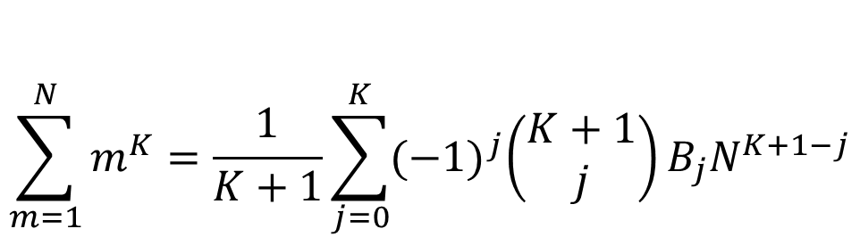
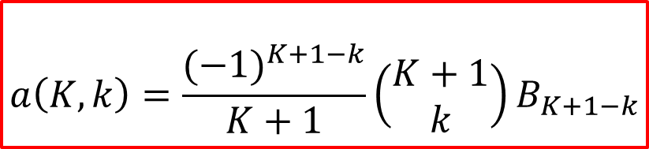
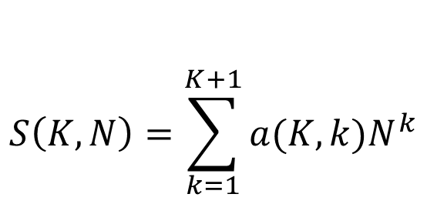
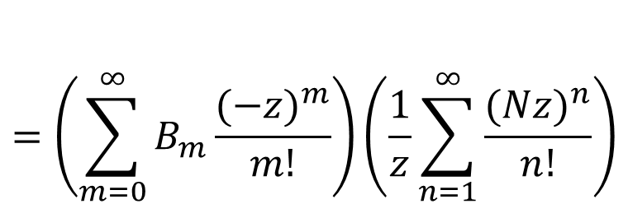
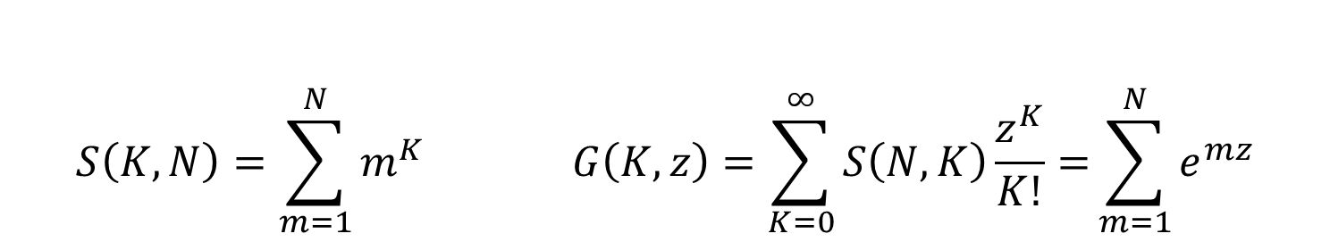
$$\sum_{m=1}^{N}{m^{K}=\frac{1}{K+1}\sum_{j=0}^{K}{{(−1)}^{j}\left(\begin{matrix}K+1 \\ j\end{matrix}\right)B_{j}N^{K+1−j}}}$$
Faulhaber’s Formula:
$$S\left(K,N\right)=\sum_{m=1}^{N}{m^{K} G\left(K,z\right)=\sum_{K=0}^{∞}{S\left(N,K\right)\frac{z^{K}}{K!}=}}\sum_{m=1}^{N}{e^{mz}}$$
Generating function
$$=\left(\sum_{m=0}^{∞}{B_{m}\frac{{(−z)}^{m}}{m!}}\right)\left(\frac{1}{z}\sum_{n=1}^{∞}{\frac{{(Nz)}^{n}}{n!}}\right)$$
$$S\left(K,N\right)=\sum_{k=1}^{K+1}{a(K,k)N^{k}}$$
$$a\left(K,k\right)=\frac{{(−1)}^{K+1−k}}{K+1}\left(\begin{matrix}K+1 \\ k\end{matrix}\right)B_{K+1−k}$$
Notes:
(%) I looked up Bernoulli number in Wikipedea, and there was a section on the sum of powers. The close form formula is given by the Faulhaber’s formula. The generating function is G(K,z) and can be shown to equal to the second line containing the Bernoulli numbers. We juggle the index of summation and we get the close form formula for the a coefficient.

Slide 22
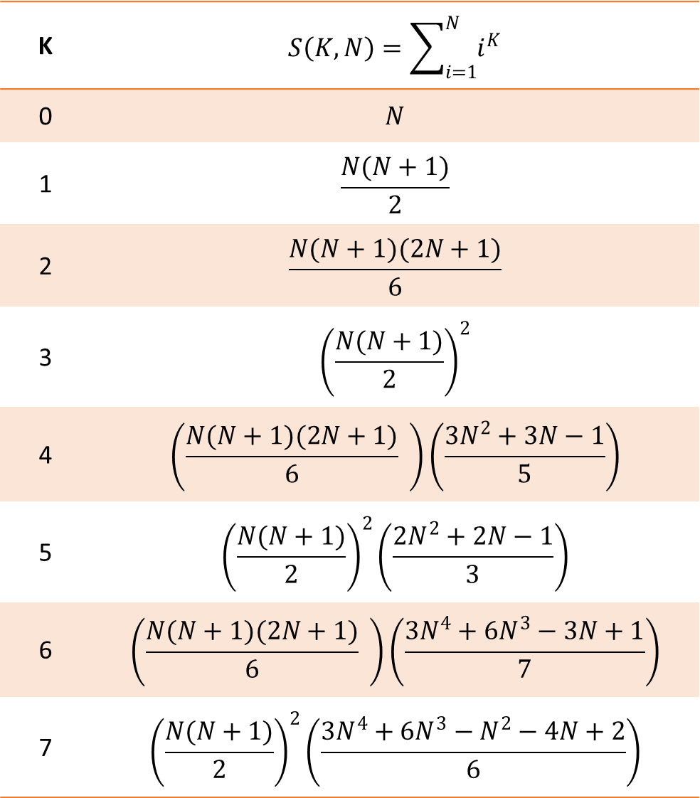
K | $$S\left(K,N\right)=\sum_{i=1}^{N}{i^{K}}$$
0 | $$N$$
1 | $$\frac{N(N+1)}{2}$$
2 | $$\frac{N(N+1)(2N+1)}{6}$$
3 | $${\left(\frac{N(N+1)}{2}\right)}^{2}$$
4 | $$\left(\frac{N(N+1)(2N+1)}{6} \right)\left(\frac{3N^{2}+3N−1}{5}\right)$$
5 | $${\left(\frac{N(N+1)}{2}\right)}^{2}\left(\frac{{2N}^{2}+2N−1}{3}\right)$$
6 | $$\left(\frac{N(N+1)(2N+1)}{6} \right)\left(\frac{{3N}^{4}+{6N}^{3}−3N+1}{7}\right)$$
7 | $${\left(\frac{N(N+1)}{2}\right)}^{2}\left(\frac{{3N}^{4}+{6N}^{3}−N^{2}−4N+2}{6}\right)$$
Notes:
(%) Here are the formulas for the first 7 powers. This is obtained after factoring. We see there is a common factor for the even and odd cases when K>1. This form makes it easy to verified that the polynomial is 1 when we set N=1.

Slide 23
QUESTION?
Notes:
(%)

Slide 24
THANK YOU
Notes:
(%)

